Slide 1
OS HW3
Multi-Threading Programming
Operating System 110 Fall Professor: W.J. TSAI TA. 張皓雲 姚淨云 林孟學 王彥珽

Slide 2
APIs
Thread management: <pthread.h>
pthread_create
pthread_join
pthread_exit
Reference: POSIX Threads Programming | LLNL HPC Tutorials
Notes:
這是建議同學使用的API pthread是一個最接近系統端的api 其中裡面有三個function是這次作業會使用到的 第一個pthread_create() 就是讓你拿來create thread用的 pthread_join是讓主執行續等待其他thread執行完用的 pthread_exit是當thread執行完之後要記得使用

Slide 3

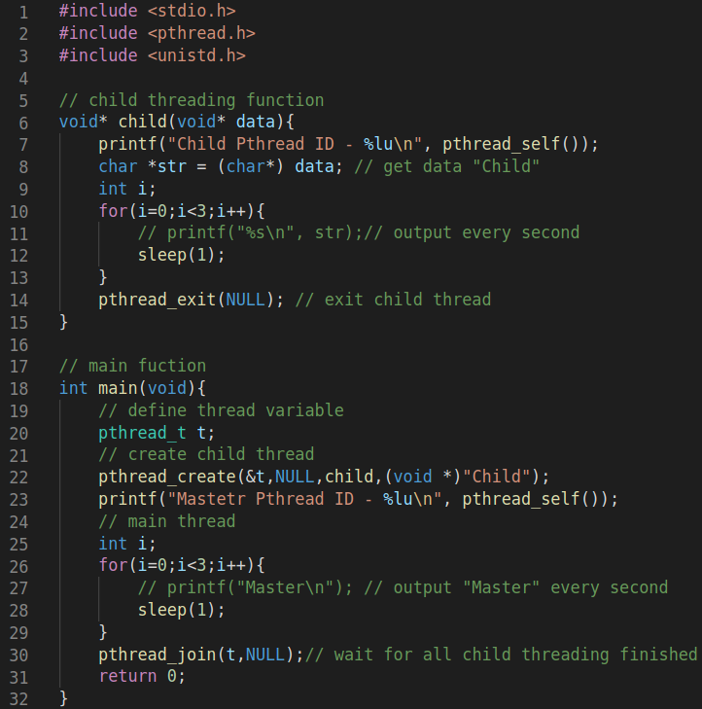

Exercise - Hello Thread
hello_thread.c
Output
You don’t need to submit hello_thread.c and put screenshot in report.
Notes:
然後這是讓同學能夠練習thread怎麼使用 的一個練習的.c檔案 右邊是這個.c檔的執行結果 記得在執行檔案時需要加上-lpthread連結pthread這個函式庫

Slide 4
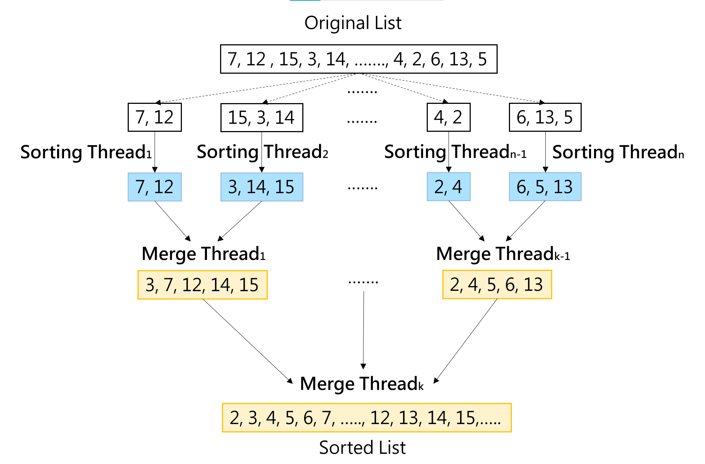
HW3-1 Single-threaded Sorting
Bubble sort
Bubble sort
Bubble sort
Merge
Merge
Merge

Slide 5
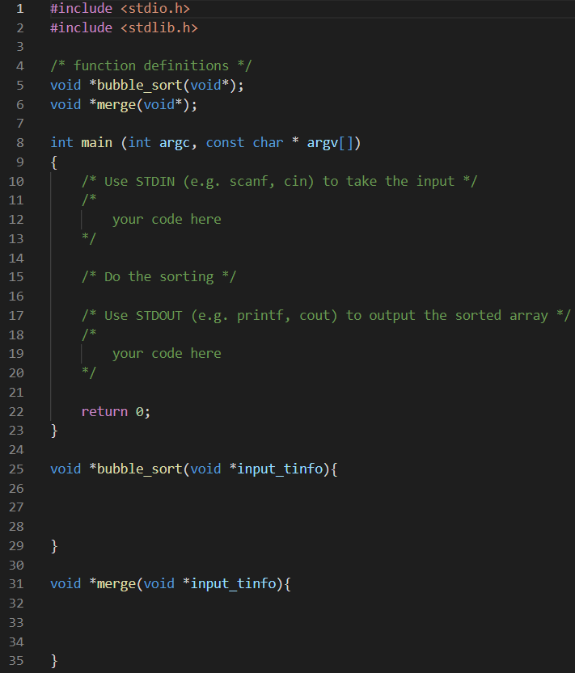
HW3-1 Single-threaded Sorting
You should implement:
STDIN (e.g. scanf, cin)
buble_sort function (use brute‐force methods)
merge function
STDOUT (e.g. printf, cout)
DO NOT USE FILE I/O !
Single thread’s partitions should be the same to multithread’s partitions.

Slide 6
HW3-2 Multithreaded Sorting

Slide 7
Multithreaded Sorting
A list of integers is divided into several smaller lists.
Using different threads (sorting thread1 ~ sorting threadn) sort each sublist using any brute‐force methods (e.g., bubble sort).
The several sublists are then merged into a single sorted list by threads (merging thread1 ~ merging threadk.
You should implement:
STDIN (e.g. scanf, cin)
Sorting thread function (Use brute‐force methods, e.g., bubble sort)
Merge thread function (Use simple merge sort for merging two sublists)
Thread management
STDOUT (e.g. printf, cout)
DO NOT USE FILE I/O !
Notes:
口頭說明 n k 的意思

Slide 8
Compile & Run Commands
Compile:
(single-thread) $ g++ -o studentID_ST studentID_ST.c
(multi-thread) $ g++ -o studentID_MT studentID_MT.c -lpthread
Run:
(single-thread) $ time ./studentID_ST < input1.txt > output1_ST.txt
(multi-thread) $ time ./studentID_MT < input1.txt > output1_MT.txt
Environment
You should run your code on the multiple CPU.
Notes:
有兩個input1.txt input2.txt 口頭說明 一個10000個integers, value 介於 0 到 900000

Slide 9
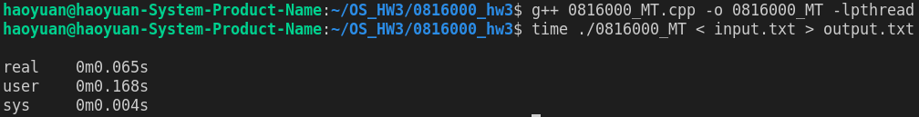
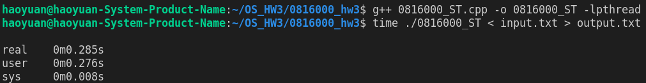
Compile & Run Commands
Performance between single thread and multi thread:
Find the difference between answer and your output:
diff --suppress-common-lines answer{1,2}.txt ouput{1, 2}.txt (answer{1, 2}.txt is provided by TA)

Slide 10
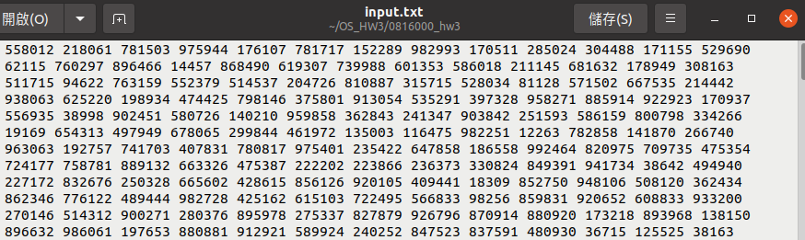
Input/output format
Input format:
All elements will separated by space
Largest input: 1,000,000 integers
Integer value was random from 0 to 1000000

Slide 11
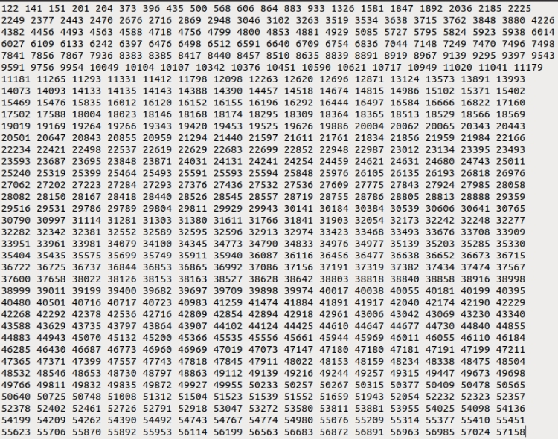
Input/output format
Output format:
1. Use SPACE between every two numbers
2. No need newline
output_{ST, MT}_{1, 2}.txt

Slide 12
Requirements
The sorting threads should use the same sorting algorithm as the single-thread program.
Multi-thread sorting should be much faster than Single-thread sorting, and their results must be exactly the same.
Write your codes in c/c++
You need to hand in one single-thread version and the other multithread version. Put studentID_ST.c(.cpp), studentID_MT_best.c(.cpp), studentID_MT_worst.c(.cpp) and studentID_report.pdf into the same compressed file without folder.
The type of compressed file must be “studentID_hw3.zip”
Use Ubuntu or NYCU work station as your environment.

Slide 13
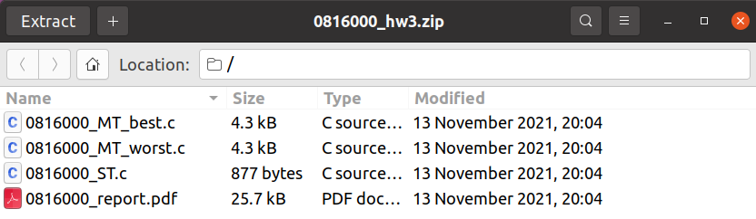
Requirements
The compressed file needs to be compressed as follows:

Slide 14
Grading
Total score: 100 pts. COPY WILL GET 0 POINT!
Single-thread program: 20 pts (correctness)
Two Multi-thread programs: 40 pts (correctness)
Report: 40 pts
Incorrect file format: -10 pts
Use FILE I/O: -5 pts
Deadline: 2021/12/1 (Wed) 23:59
Late submission will get a -20% point per day.

